Slide 1

IMAGE CLUSTERING USING TRANSFER LEARNING (VGG16 ,VGG19,RESNET50)
Pranitha Nimmagadda

Slide 2
ABSTRACT:
Now a days, every one will have thousands of ungrouped single images of different sizes in their phone or storage devices.
It is difficult task to group them manually and it also time taking process.
In this project ,we introduce a transfer-learning algorithm that finds similarity between images and group them separately.

Slide 3
Introduction
Images to us, humans, are naturally processed through our vision and brain systems.
We learn to recognise what things are without being explicitly told how to do so. To a computer, images are a series of numbers representing the brightness of different colours in particular parts of the image .

Slide 4
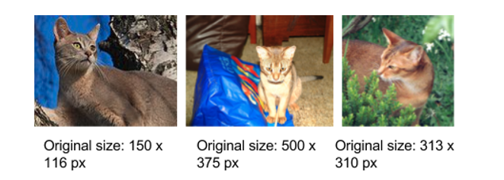
DATA SET
We​ ​will​ ​be​ ​using​ ​the​ ​Oxford​ ​IIIT​ ​Pet​ ​dataset,​ ​comprising​ ​of​ ​images​ ​of​ ​37​ ​categories​ ​of​ ​pet breeds,​ ​12​ ​of​ ​cats,​ ​and​ ​25​ ​of​ ​dogs and each category of 200 images.(7380 images).
​ ​The​ ​images​ ​are​ ​of​ ​different​ ​scales,​ ​poses​ ​and​ ​light​ ​levels.This​ ​is​ ​in​ ​contrast​ ​to​ ​some​ ​other​ ​datasets​ ​which​ ​will​ ​have​ ​a​ ​more​ ​uniform​ ​set​ ​of​ ​images.

Slide 5
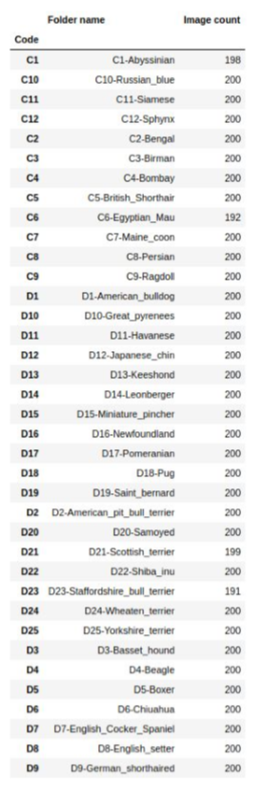

Slide 6
Algorithms​ ​and​ ​Techniques
OpenCV:​ ​Image​ ​reading​ ​and​ ​resizing.
SciKit-Learn:​ ​Data​ ​shuffling,​ ​Kmeans​ ​and,​ ​Principal Component​ ​Analysis,​ ​and​ ​performance​ ​metrics.
Pre-trained models:​ ​VGG16,​ ​VGG19​ ​and​ ​ResNet50​ ​convolution​ ​network models​.

Slide 7
Convolution Neural Network:
Convolutional neural networks are neural networks whose architecture takes advantage of knowing that the input is an image in order to improve classification ability and reduce the number of parameters. Their layers are arranged in 3 dimensions, and each neuron is only connected to a small part of the layer before it, not to all nodes as we would expect in a fully connected layer.
Convolutional networks also use pooling layers to reduce the spatial size of the data. Pooling layers downsize the data by taking a number of features and transforming them into a single feature by applying a chosen function to them. A common function is the Max function where the new feature has the same value as the largest of the old features.

Slide 8
TRANSFER LEARNING
Transfer learning is a research problem in machine learning (ML) that focuses on storing
knowledge gained while solving one problem and applying it to a different but related problem.
There are a some pre-trained machine learning models out there that are quite popular some of them are:
1.VGG16
2.VGG19
3.RESNET50

Slide 9
WHY TO USE TRANSFER LEARNING :
To reduce the number of features we are using VGG19 , VGG16 , RESNET so that the model is
capable of only having few features.
For example:
If our resized of image is 244*244 pixels
Then the array we get is (244,244,3) (3 matrixes because of RGB colors)
i.e 244*244*3=1,78,608
--Therefore for each image we are having 1,78,608 features

Slide 10
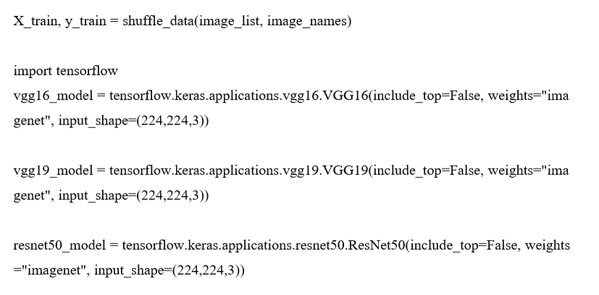


Slide 11
Principal component analysis (PCA):
Principle component analysis is a technique that brings out the variations in the dataset.
It reduces the number of features of a data set such that the features it provides produce maximum variance between the points.
This allows us to represent the differences between the different points in less features, and makes it easier for our clustering algorithms to operate.

Slide 12
KMeans clustering:
KMeans clustering is a method that clusters data points together based on feature similarity. It starts by randomly assigning data points to clusters and then works on minimising the eucledian distances of points from their cluster centroids.

Slide 13
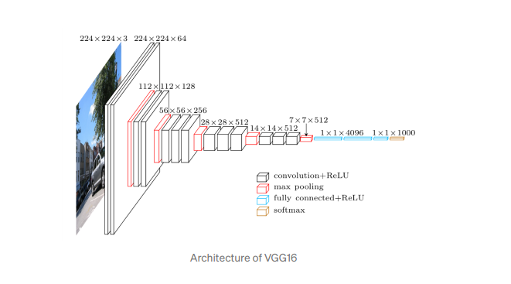
ARCHITECTURE DESIGN:
KMEANS

Slide 14
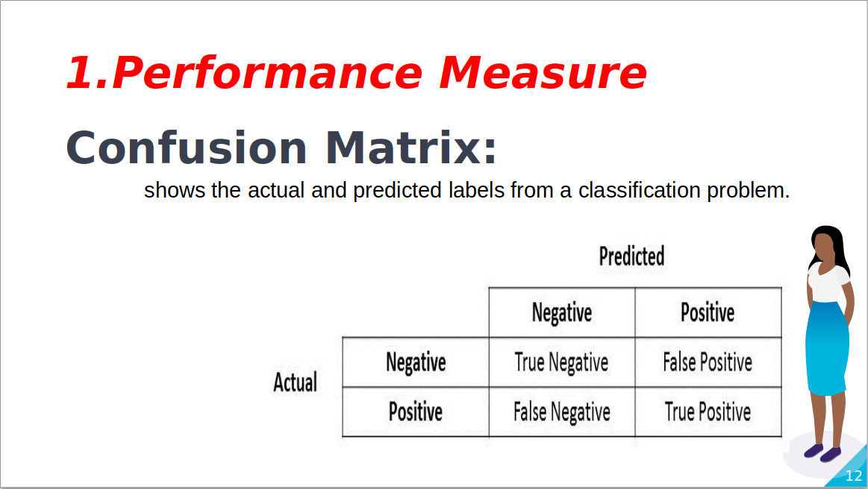

Slide 15
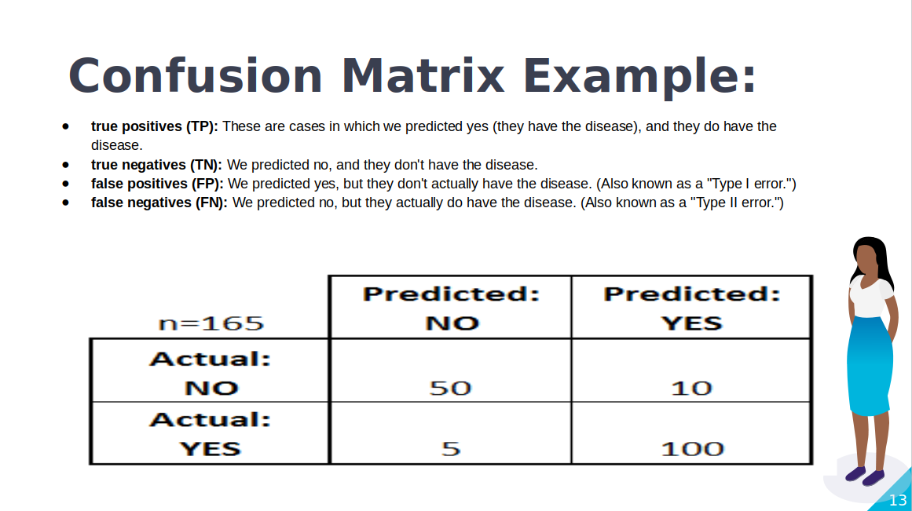

Slide 16
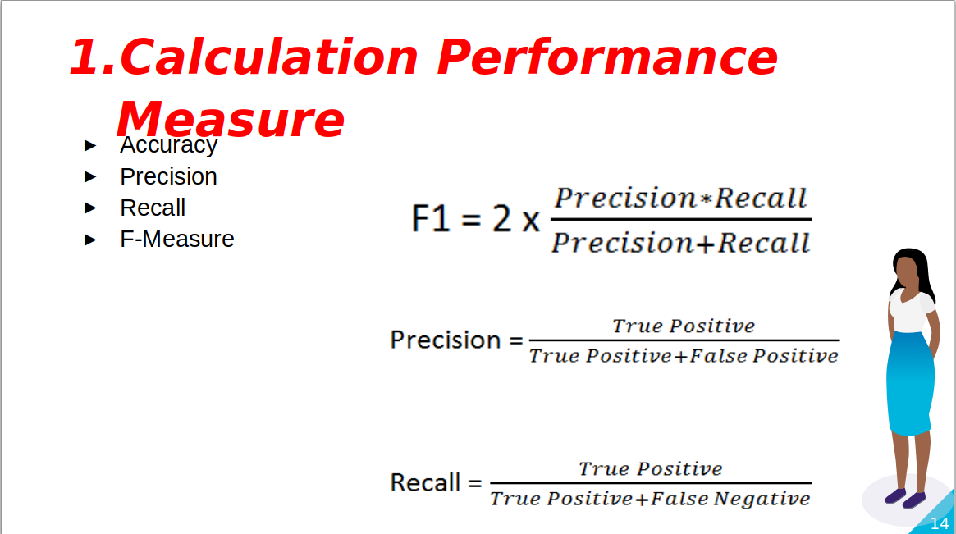

Slide 17
MODELS IN THIS PROJECT:
Kmeans +PCA+VGG16
Kmeans +VGG16
Kmeans +PCA+VGG19
Kmeans +VGG19
Kmeans +PCA+ResNet50
Kmeans +ResNet50

Slide 18
Implementation
In general notion of representing images by using convolutional networks and then separating them using unsupervised clustering algorithms is applicable to many datasets.
The images were also manually moved from being in a single folder, to placing images of the different breeds in their own subfolders.
Images were already labelled in their filenames with which breed they were of, and so we do not expect this process to have misplaced any breed images in the wrong folder. This was done to simplify .

Slide 19
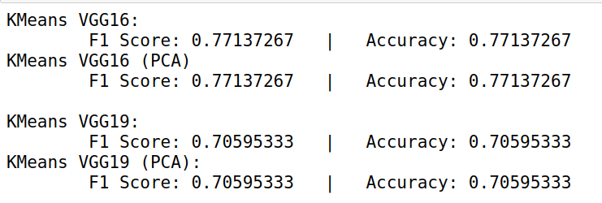
RESULT:
For categories of C1,C8,D25,D9 are:

Slide 20
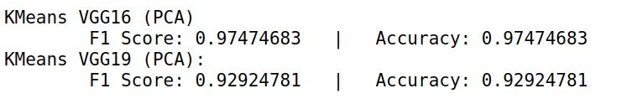
For categories of c8,c12 are:

Slide 21
CONCLUSION:
In this project,​ KMeans​ ​/​ ​VGG16​ ​combination​ ​is​ ​a​ ​suitable​ ​model​ ​for​ ​our​ ​dataset.​ ​
It​ ​has​ ​solved​ ​our problem ​to​ ​a​ ​different​ ​extent​ ​depending​ ​on​ ​the​ ​breed​ ​combinations

Slide 22
THANK YOU……!!!!!

